Slide 1

High Speed Self-Correcting Circuit for Space Applications
Presented by:
Joseph Caglio and Allison Villa
Mentor: Dr. Janet Wang
University of Arizona - Electrical and Computer Engineering
Assistant Professor

Slide 2

Introduction
Drastic temperature changes and Radiation can:
  Cause space crafts to malfunction
  Damage the inner components of circuits
  Cause circuits to output false data
Need an error correcting circuit called the Razor Circuit

Slide 3
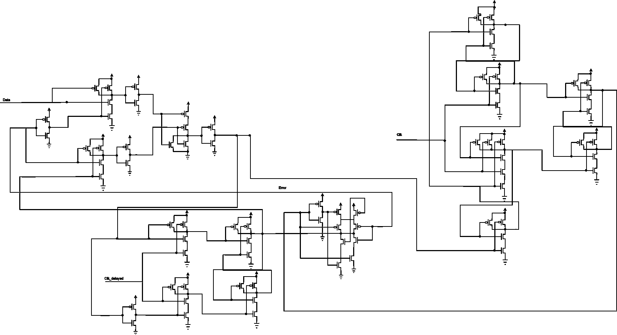
What is the Razor Circuit?
Developed by the Razor team
General Purpose: Error detecting and correcting
Redrawn from “Razor: Circuit-Level Correction of Timing Errors for Low-Power Operation” – Todd Austin and et al

Slide 4
How does the Razor Circuit work?
Circuit
A
Main Storage
Circuit
B
ERROR!
Storage
Compare

Slide 5
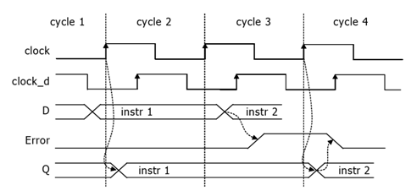
How does the Razor Circuit work?
From “Making Typical Silicon Matter with Razor” – Todd Austin and et al

Slide 6
Simulation of the Razor Circuit
Clock 1
Problem with the Razor Circuit? Speed is hindered
Clock 2
Data
Error
Output
0.6 ns

Slide 7
Speed-Up Option
Purpose: Speeds up the communication between two data units

Slide 8
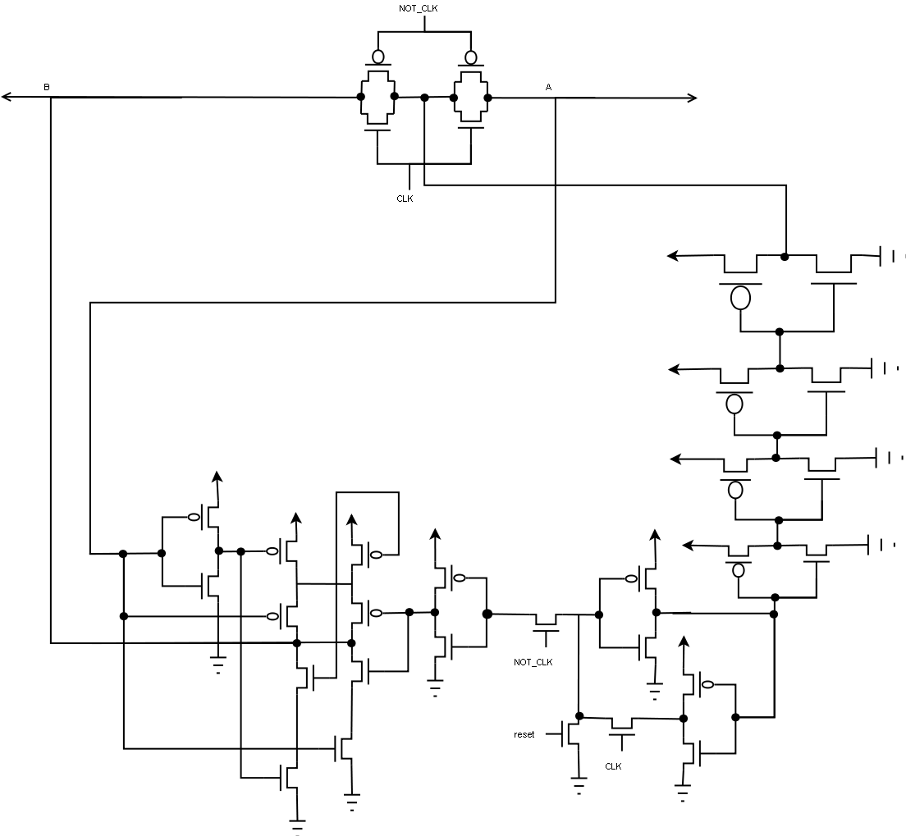
What is a Coding Unit?
Redrawn from “On-chip Bidirectional Wiring for Heavily Pipelined System using Network Coding”

Slide 9
How does Coding Unit Work?
Data AB
Data A
Data B
Data A
Data B
Data AB
Data A
Data B
Data B
Data A

Slide 10
Simulation of the Coding Unit
Clock
- Clock
Data A
Data B
Data AB

Slide 11
Simulation of Razor with Coding Unit
Clock 1
Clock 2
Data
Error
0.4 ns
Output

Slide 12
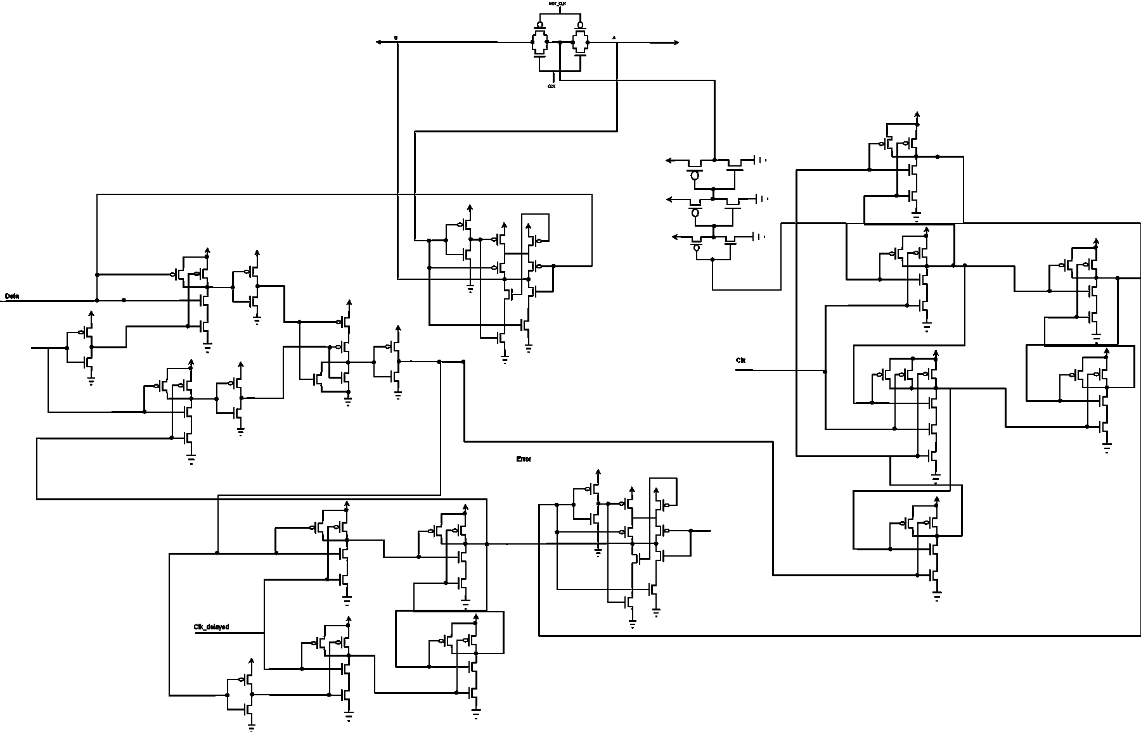
High Speed Self-Correcting Circuit

Slide 13
Obstacles
Labeling of wires
Timing
Different circuit models
Unstable signals
Inputs signals

Slide 14
Conclusion
Problem: Circuit malfunction in space
Solution: Razor Circuit (Self-Correcting)
  Problem: Too slow
  Theory: Coding Unit
Debugging
Result: High Speed Self-Correcting Circuit

Slide 15
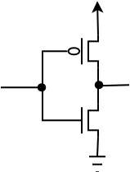

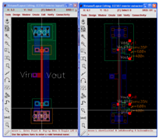
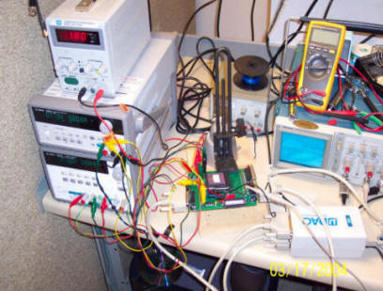
Future Plans
From “Razor: A Low-Power Pipeline Based on Circuit-Level Timing Speculation” – Dan Ernst et al

Slide 16
References
“Making Typical Silicon Matter with Razor” – Todd Austin, David Blaauw, Krisztián Flautner, Trevor Mudge
“On-chip Bidirectional Wiring for Heavily Pipelined System using Network Coding”
“Razor: A Low-Power Pipeline Based on Circuit-Level Timing Speculation” - Dan Ernst, Nam Sung Kim, Shidhartha Das, Sanjay Pant, Todd Austin, et al
“Razor: Circuit-Level Correction of Timing Errors for Low-Power Operation” – Todd Austin, David Blaauw, Shidhartha Das, Dan Ernst, Krisztián Flautner, et al
Acknowledgments
Dr. Janet Wang
Su Ling
Arizona State University
University of Arizona/NASA Space Grant Program
  Susan Brew
  Dr. Barron Orr

Slide 17
THANK YOU!

